Slide 1

Real-time geospatial Data processor and visualizer
Client: Werner Raath (CSIR)

Slide 2
overview
Background
Use cases
Functional requirements
Technologies
Infrastructure

Slide 3
BACKGROUND

Slide 4
Background
Description
Project scope
Vision

Slide 5
Uses cases

Slide 6
Use Cases
General User
Technical User (from Technical Actors)
Science User (from Science Actors)
Regulatory User (from Regulatory Actors)
Planning User (from Planning Actors)
High Level User(from High Level Us

Slide 7
Functional requirements

Slide 8
Functional requirements
Disaster Manager
Display hazards as soon as they are reported
Stream updates to user if tracked
Display user-specific geospatial data at different points in time (Time Series data)
Display specific queries
Climate Manager
Display weather changes over time, etc. wind, temperature changes
Display specific queries

Slide 9
Technologies

Slide 10
Technologies
Data Collection:
3rd party API’s
Store data into our own database (RethinkDB)
NodeJS server
Map:
OpenLayers + OpenStreetMap + WebGL
Database:
RethinkDB

Slide 11
Technologies
Server:
NodeJS + ExpressJS and RabbitMQ (Messeage queuing )
Web-Client Frameworks:
AngularJS
Container:
Docker

Slide 12
Structural Pattern

Slide 13
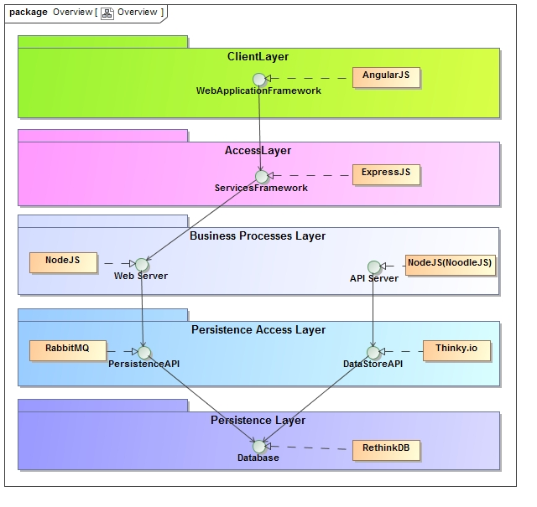

Slide 14
SLACK

Slide 15
Key points
https://coeus2016.slack.com
Our official communication channel with client

Slide 16
Wafflie.io

Slide 17
Key points
Scrum board
Linked with github issues and milestones

Slide 18
GITHUB

Slide 19
KEY points
git-flow for branch management

